Slide 1
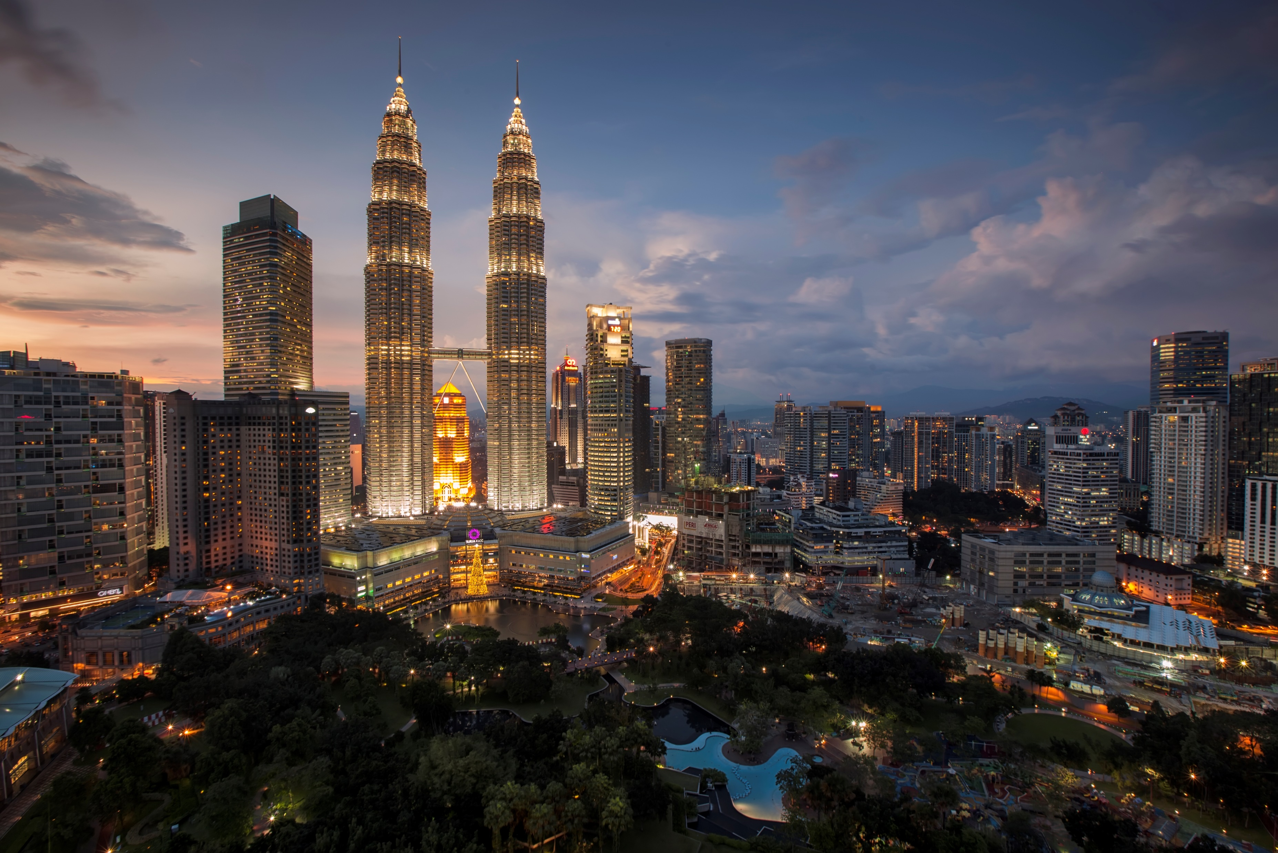
IBM Applied Data Science Capstone
By : Sanskriti Tiwari

Slide 2
Introduction
In a recent survey, shopping was considered as a great refreshment activity. Many people find that visiting a shopping mall is a great way to relax themselves during holidays and weekends.
Nowadays, if we look around, we find numerous people in shopping malls. This is because Shopping malls are a one-stop destination for people. They are very convenient as people can watch movies, dine at restaurants, do grocery shopping, play games and perform many such leisure activities all at one place.
Property builders take advantage of this fashion and build more shopping malls to satisfy the demands of people. As a result of this, there are numerous shopping malls in the city of Kuala Lumpur, Malaysia and numbers increase continuously. Shopping malls provide consistent rental incomes to property builders.
However, building a shopping mall requires many factors to be taken into consideration. One of the most important factor is the location of shopping mall. Location is the most important decision as it determines whether the mall will be success or a failure.

Slide 3
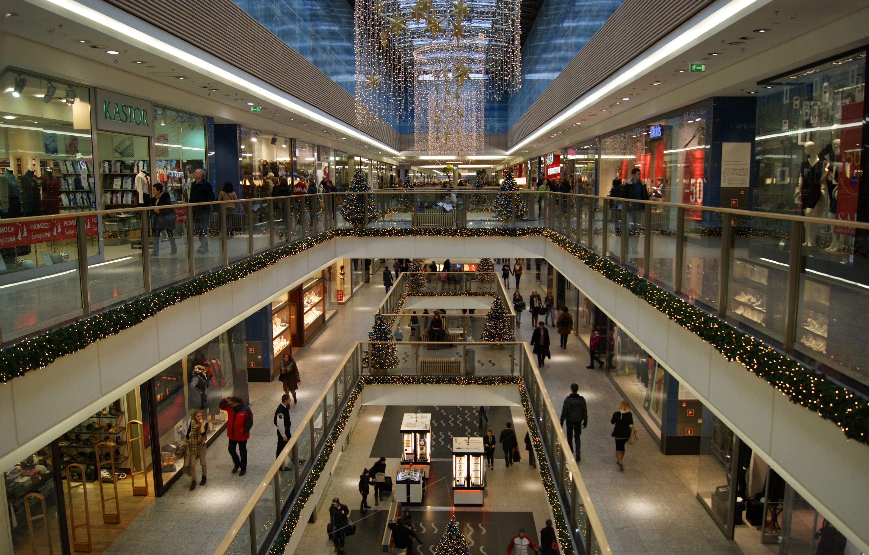
Business Problem
The main objective of this capstone project is to analyse and select the best location to open a shopping mall in the city of Kuala Lumpur, Malaysia.
We will use data science methodology and machine learning technique like clustering and segmentation to achieve our goal. This project aims to answer the business question : In the city of Kuala Lumpur, if a builder wants to open a shopping mall, where would you suggest him to open it?
This Photo by Unknown Author is licensed under CC BY-SA

Slide 4
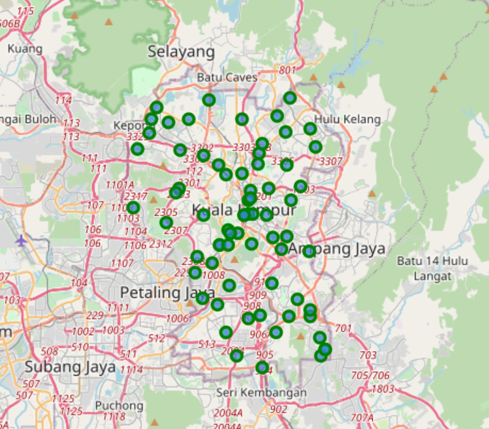
Data
To provide a solution to the problem, we will need the data:
List of neighborhoods in the city of Kuala Lumpur, capital of Malaysia, a country in South-East Asia.
Geographical coordinates (Latitude and Longitude) of these neighborhoods in order to plot map and get venue data associated to these neighborhoods
Venue data with respect to each neighborhood, particularly of shopping malls. This data will be used to cluster neighborhoods

Slide 5
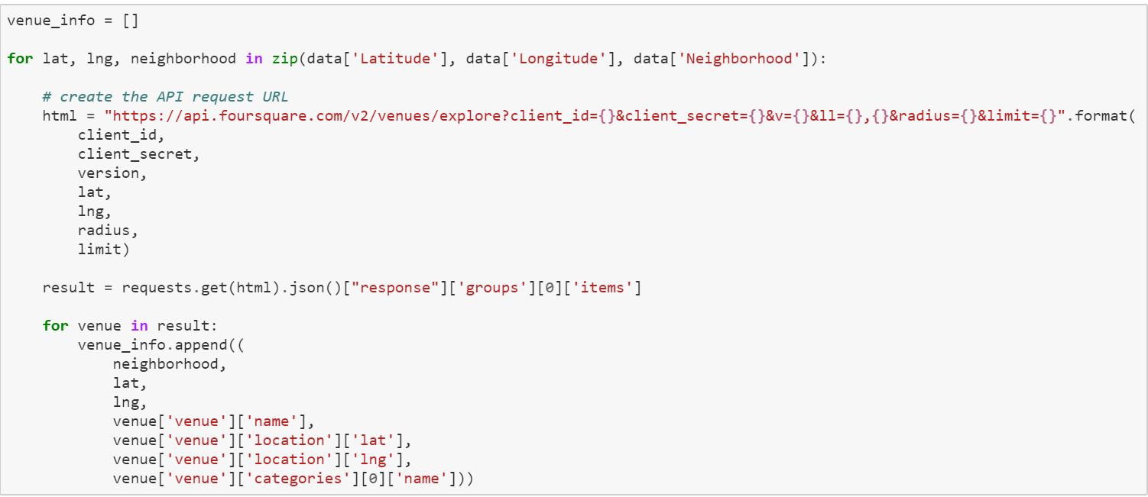
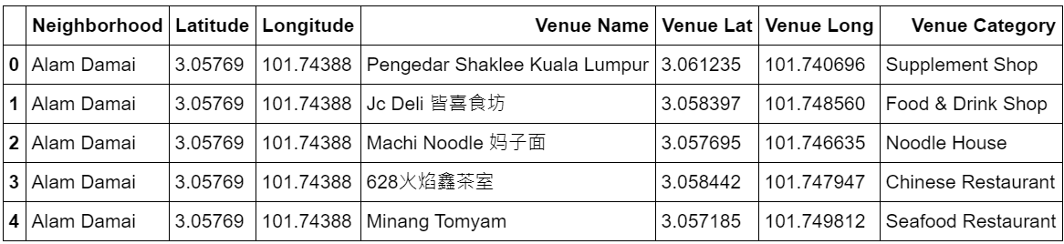
Approach
Fetching Venue data for every neighborhood
Merging Data

Slide 6
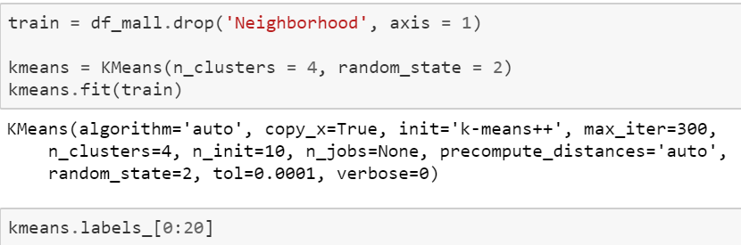
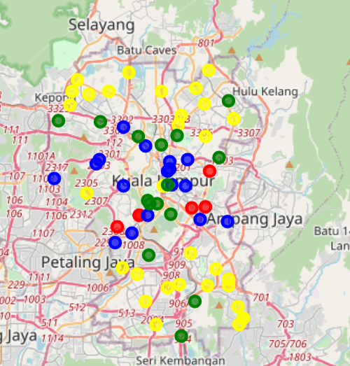
Applying Clustering

Slide 7
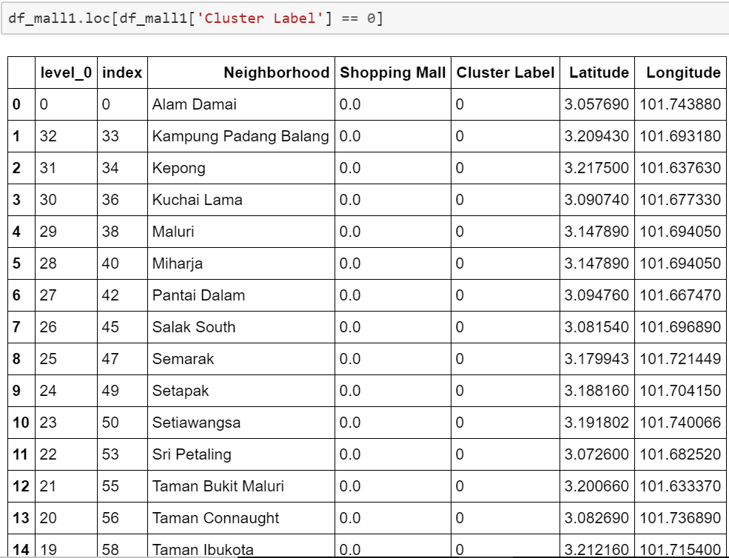
Cluster 0

Slide 8
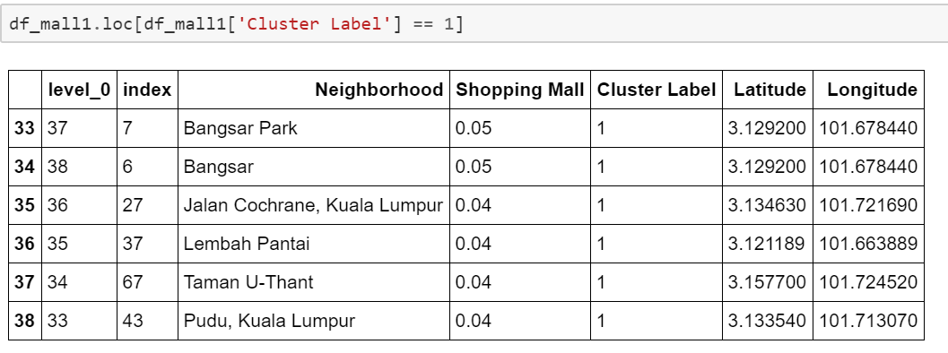
Cluster 1

Slide 9
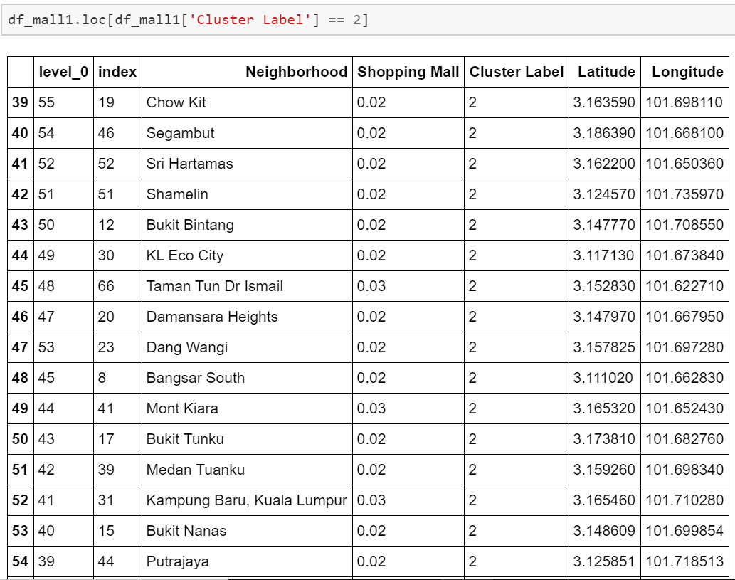
Cluster 2

Slide 10
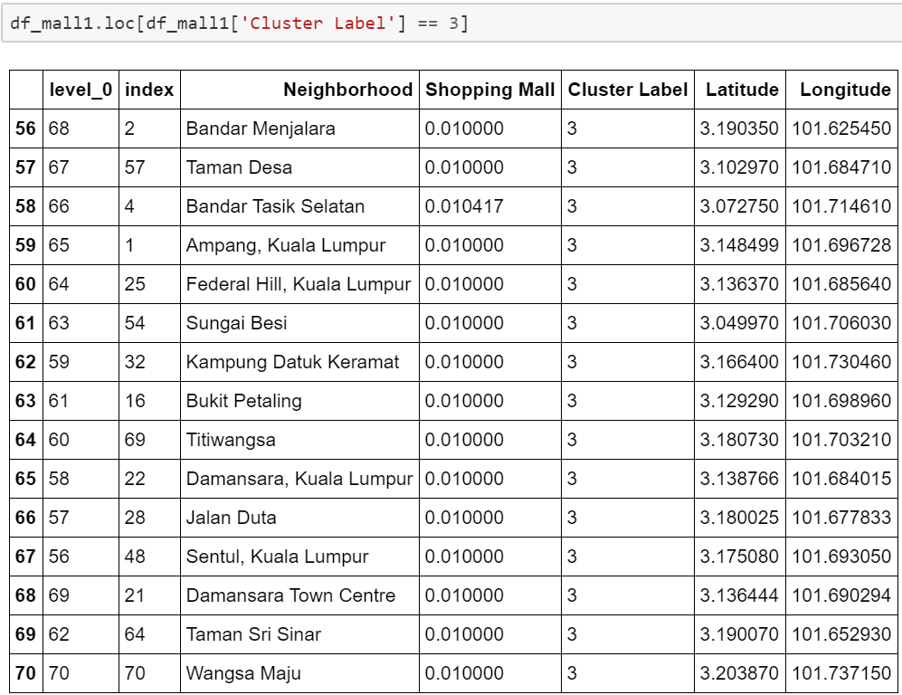
Cluster 3

Slide 11
Conclusion
From the analysis done in our project, we conclude that the best location for opening a shopping mall are the neighborhoods present in Cluster 0.
Also, it seems that neighborhoods in Cluster 1 and 2 are densely populated with shopping malls and therefore, the owners have to face an intense competition. Property dealers should avoid neighborhoods present in Cluster 1 and 2.
On the other hand, Cluster 0 has a very few numbers of shopping malls. Therefore, neighborhoods in Cluster 0 are suitable for the construction of a new shopping mall because they have a little or no competition and there are high chances that the shopping mall will produce more profit for the client. However, Cluster 3 can also be taken into consideration as there are only few shopping malls there.

Slide 12
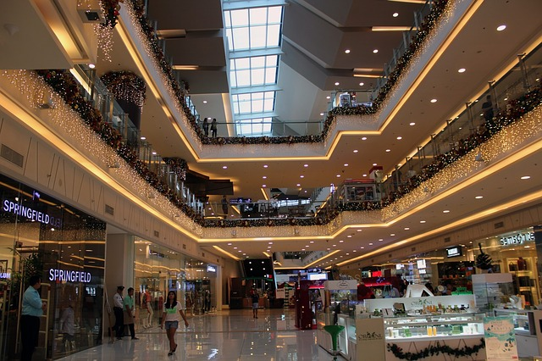
Thank You

